Slide 1
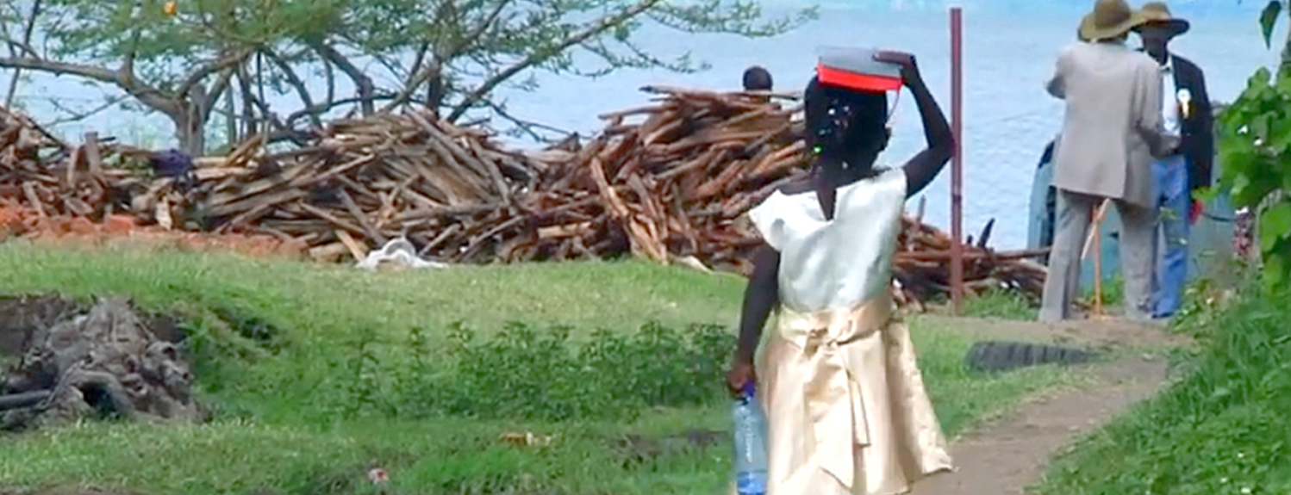
Yahweh commanded us to always keep all these statutes, to fear Yahweh our God for our good, so that he might keep us alive, as we are today. If we keep all these commands before Yahweh our God, as he has commanded us, this will be our righteousness (Deut. 6:24-25).
Therefore, everyone who hears my words and obeys them will be like a wise man who built his house upon a rock. The rain came down, the floods came, and the winds blew and beat upon that house, but it did not fall down, for it was founded on the rock (Matt. 7:24-25).
Now the goal of the commandment is love from a pure heart, from a good conscience, and from a sincere faith (1 Tim. 1:5).
All Scripture taken from the English Unlocked Literal Bible (ULB), ©2017, 2022 Wycliffe Associates, Available at https://bibleineverylanguage.org/translations, licensed under the Creative Commons Attribution-ShareAlike 4.0 International License.
The English ULB is based on the unfoldingWord® Literal Text, CC BY-SA 4.0. The original work of the unfoldingWord® Literal Text is available at https://unfoldingword.bible/ult/.
Scripture Engagement

Slide 2

What does it mean to be
engaged with Scripture?

Slide 3
The 6 Behaviors of Church-Owned Bible Translation
Mother-tongue speakers, in fellowship with their local church, take responsibility for translating the Bible into the heart language of their local community.
The local church manages community accessibility to the translated Scripture.
Continuing refinement and revision will take place within the community, with mother-tongue Christian speakers.
The church engages the local community in Scripture usage.
The local church shares the concept and methodology of church-owned Bible translation with other language communities.
The local church takes ownership of generational revisions and updates to the Scripture.
Notes:
You may remember, from when you were first trained by WA in Church-Owned Bible Translation (or COBT), that these are the 6 behaviors that follow from the 4 COBT beliefs of Ability, Authority, Responsibility, and Accountability. We are focusing here on the fourth behavior, the responsibility the church has for Scripture engagement in their own local community.

Slide 4
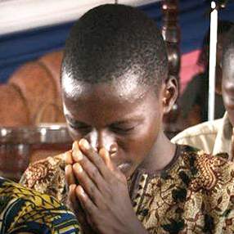
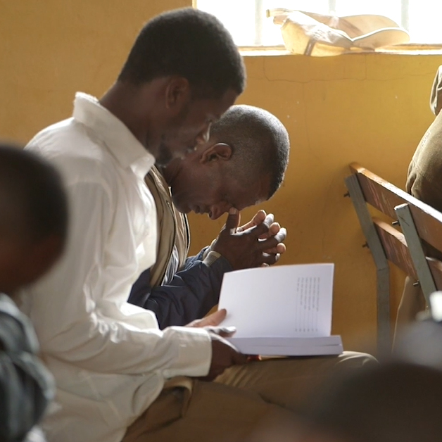
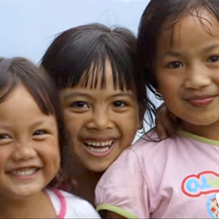
?
At church
How will the community engage with Scripture?
In Sunday school or small groups
In homes / with children

Slide 5

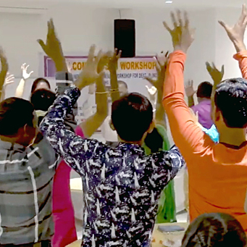
Community Change Through Scripture
More believers
Increased hope and expectation
Increased church attendance
Sinful behaviors decrease
More baptisms

Slide 6
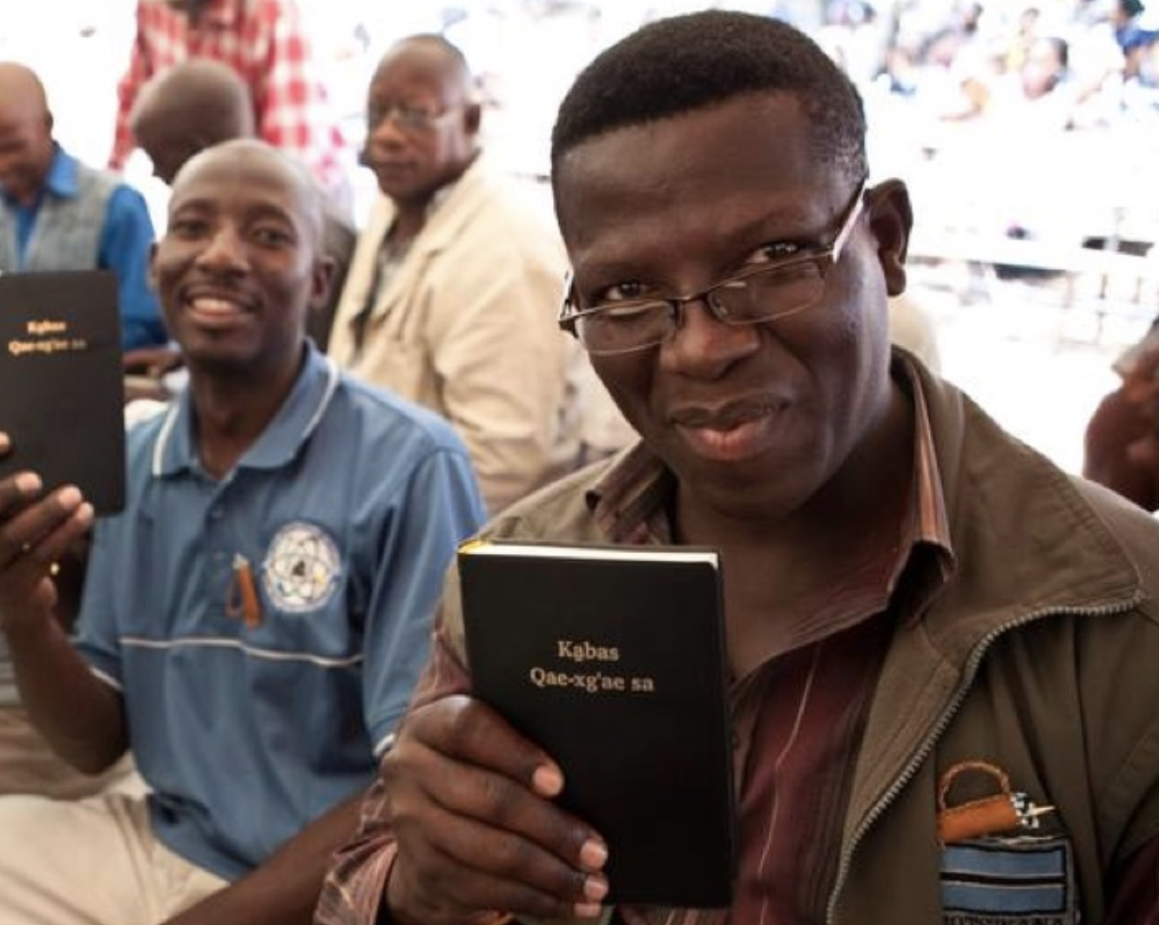
Scripture Engagement is a service for WA partners
who desire assistance.

Slide 7
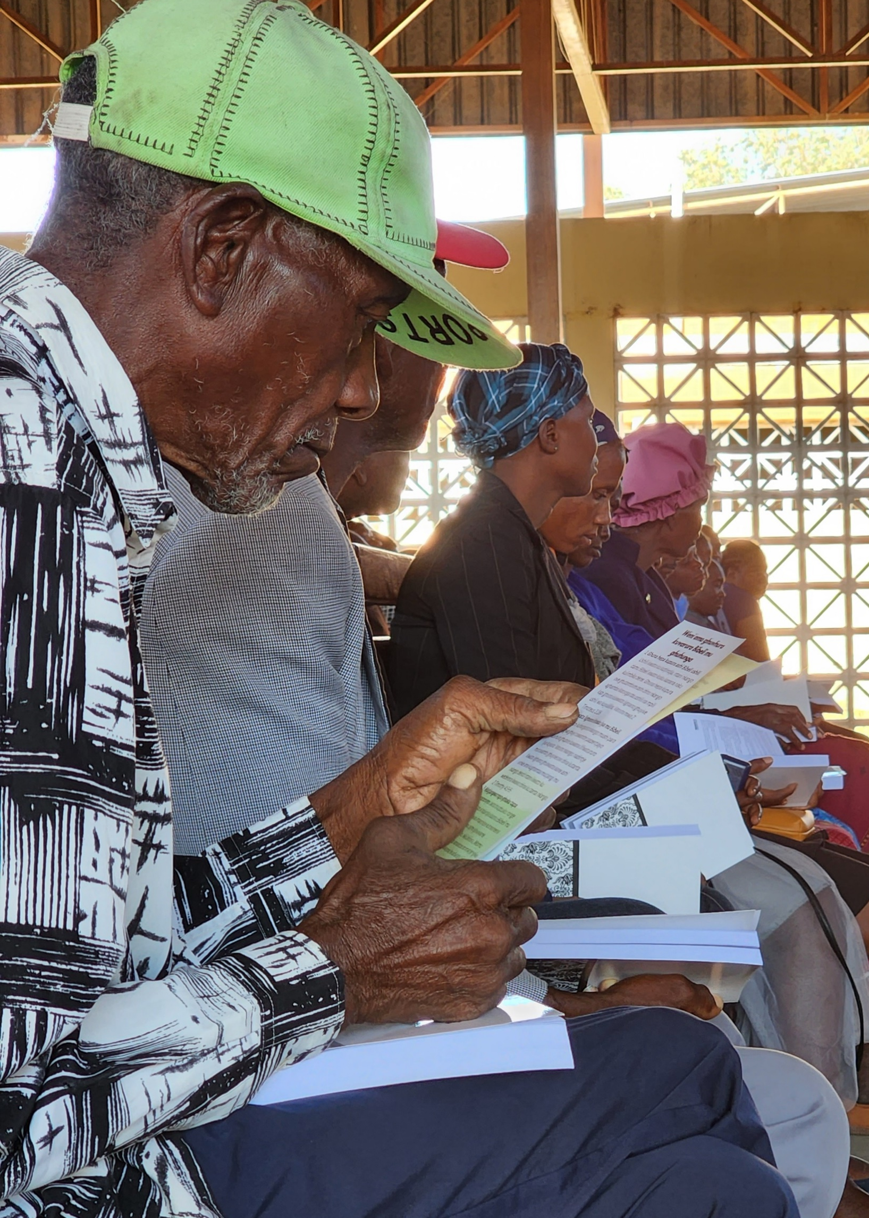
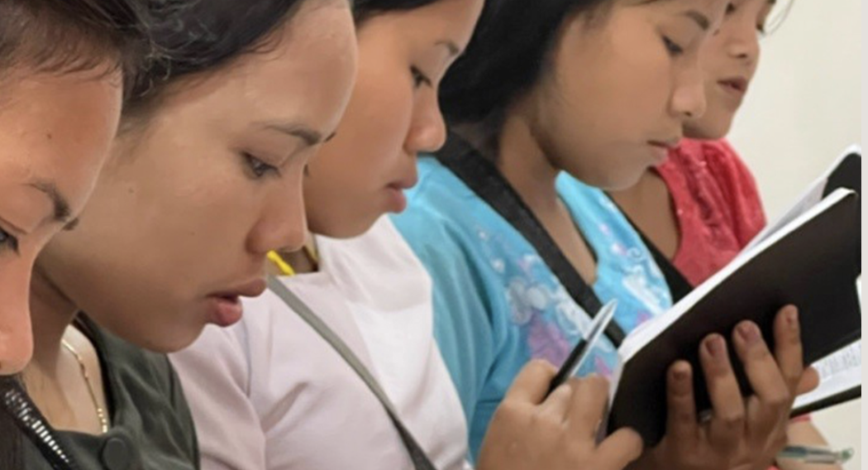
Scripture Engagement provides
training and resources
to help language groups become actively involved with
their newly translated Bible.

Slide 8
Examples of Scripture Engagement Resources
Topical devotionals
Bible studies for small groups
Reading plans / study question lists
Basic guides and worksheets for leadership or for new believers
Prayer card

Slide 9
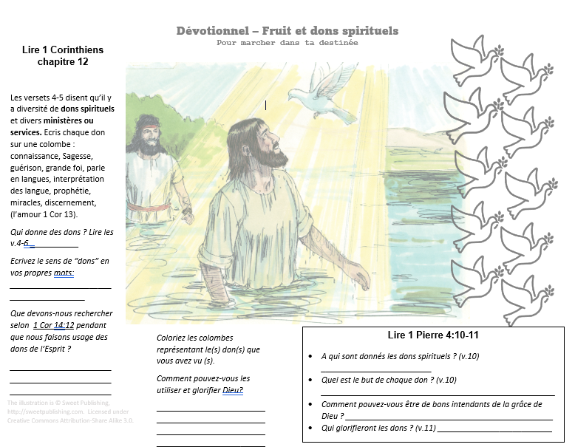
Topical Devotionals, Bible Studies

Slide 10
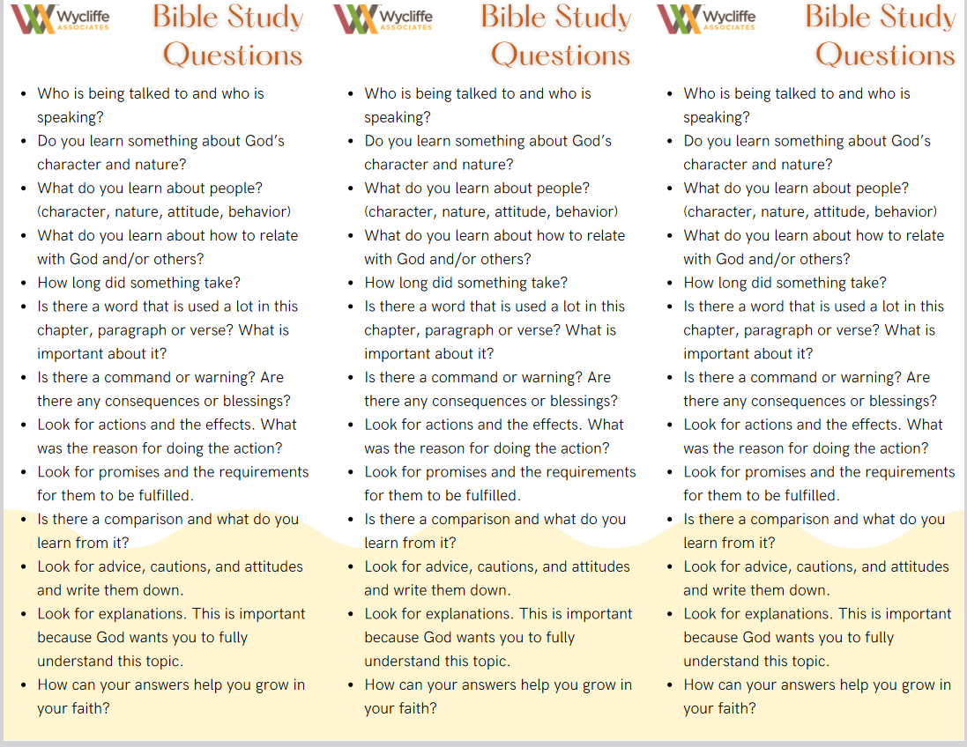
Reading Plans, Study Question Lists
Notes:
These are 3 bookmarks on 1 page. Showing that we can provide resources that are cost-effective for the community.

Slide 11
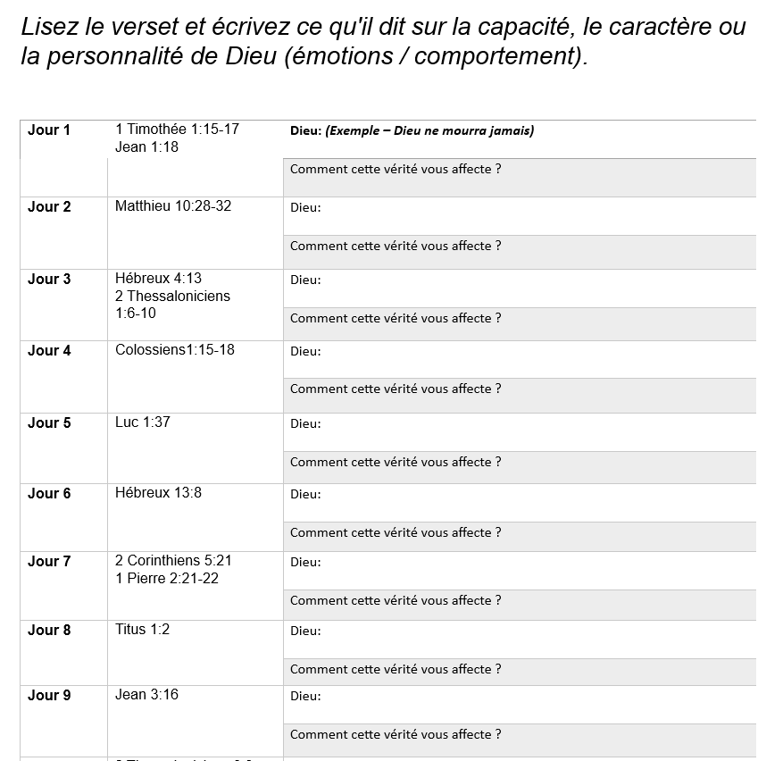
Guides/Worksheets for Leadership or New Believers
Notes:
Who is God worksheet – use to practice in the group to taste and experience the SE resources.

Slide 12





Steps for Scripture Engagement Assistance
Plan
Consider help you need
Be ready to print your Bible
Fill out the SEA form

Slide 13
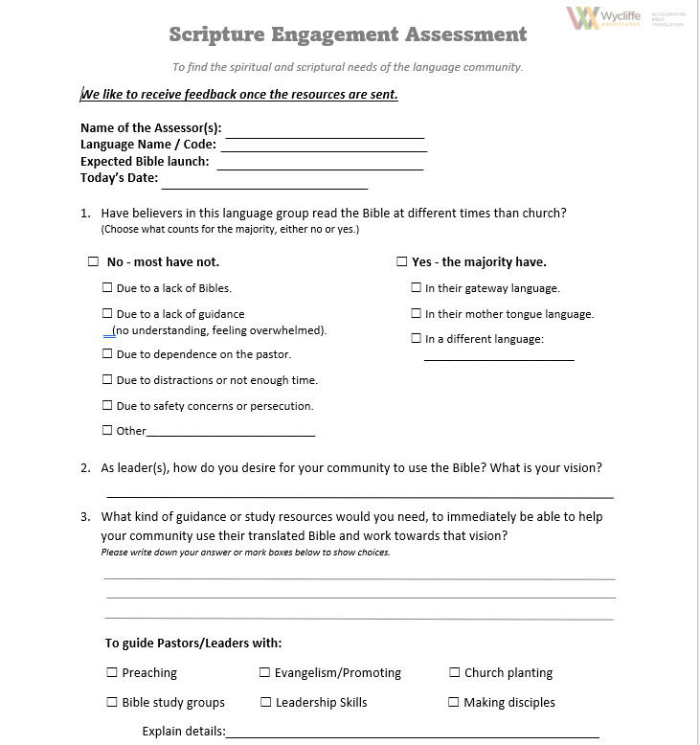
Scripture Engagement Assessment (SEA)
Notes:
Click on S.E.A. to review and create familiarity. Answer the translators’ questions if something is not clear. (Do not fill out the SEA form until ready to receive WA’s assistance.)

Slide 14


Steps for Scripture Engagement Assistance
Plan
Consider help you need
Be ready to print your Bible
Fill out the SEA form
Receive resources.
Translate if needed. Use them.
Follow up with WA

